Slide 1
Prisoners of a Broken System
Investigating the Relationship Between High Imprisonment Rates and Access to Inpatient Mental Health Care in Maryland
Jamie Pantazi

Slide 2


Introduction
Prison Industrial Complex
Coined by Angela Davis to refer to the massive industrialized profit-driven systems that make up the penal system in the US

Slide 3
Introduction
Prison Industrial Complex
Coined by Angela Davis to refer to the massive industrialized profit-driven systems that make up the penal system in the US
Research Questions
Availability of mental health care
Census tract characteristics
Spatial and demographic relationships regarding imprisonment rate
Highlight areas most in need of resources

Slide 4

Literature Review
race and class
People of color, especially Black men, are overrepresented
Money prevents inter-actions with police and consequences
Class trumps race in rural areas
Notes:
race and class
People of color, especially Black men, are more likely to become involved with the carceral system in the US
Class plays a crucial role in determining the likelihood of involvement with law enforcement
Class conditions that lead to imprisonment stretch be-yond the urban and racial factors usually associated with crime and subjugation

Slide 5
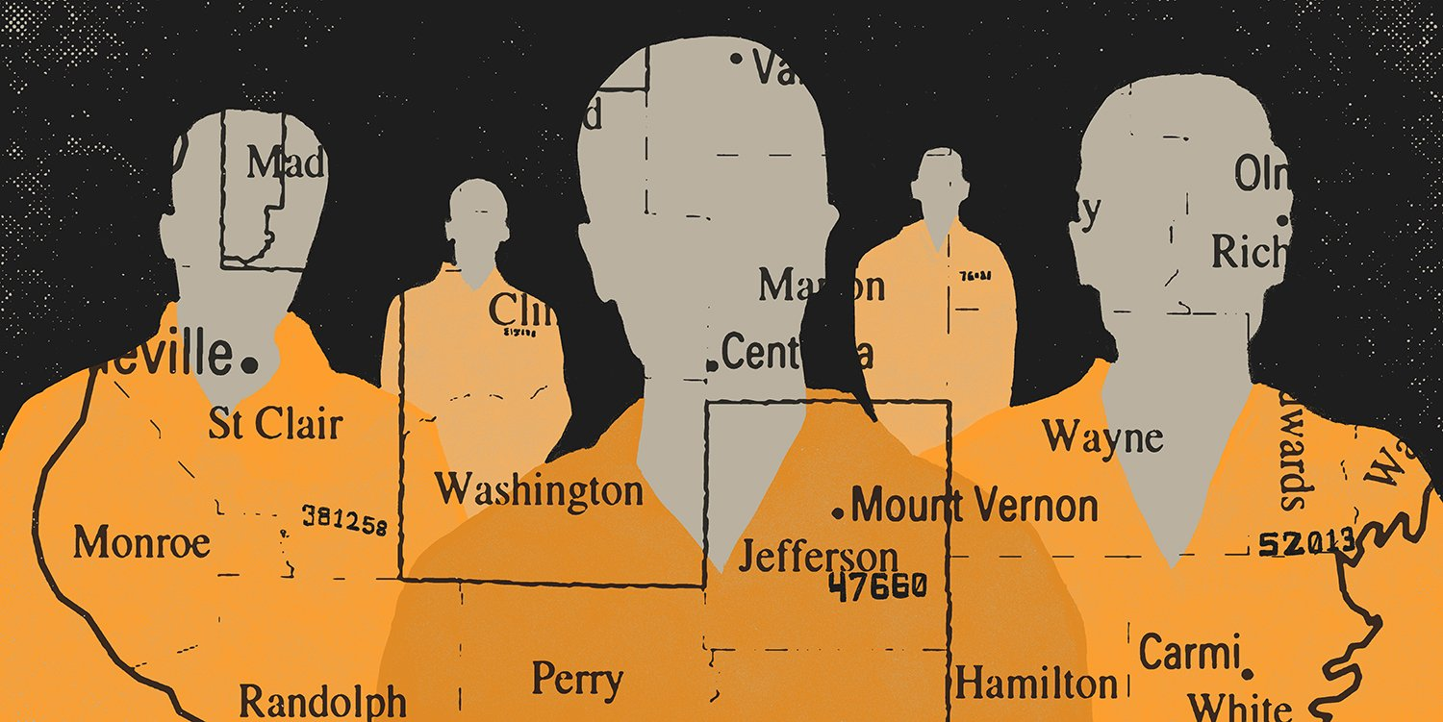
Literature Review
race and class
prison gerrymandering
People of color, especially Black men, are overrepresented
Money prevents inter-actions with police and consequences
Class trumps race in rural areas
Counting imprisoned people as residents of the place where they are imprisoned
Notes:
prison gerrymandering
The practice of counting imprisoned people as residents of the place where they are im-prisoned
As of 2021, about a dozen states had ended prison gerrymandering

Slide 6

Literature Review
race and class
prison gerrymandering
mental health
People of color, especially Black men, are overrepresented
Money prevents inter-actions with police and consequences
Class trumps race in rural areas
Barriers
Awareness
Affordability
Availability
Counting imprisoned people as residents of the place where they are imprisoned
Notes:
mental health
Barriers
Awareness
Affordability
Availability
Deprioritized in favor of more lucrative ventures
Mental health care as prevention of criminal and violent behavior

Slide 7
Hypotheses
Percent of Black residents is likely to be positively related imprisonment rates.
Median income is likely to be negatively related to imprisonment rates.
Unemployment rate is likely to be positively related to imprisonment rates
In rural areas, proximity is expected to have a stronger positive correlation with imprisonment, whereas I anticipate capacity to be more negatively influential in urban areas.

Slide 8
Findings
Confirms previous research around race, income, and unemployment having precise and noteworthy associations with im-prisonment rates

Slide 9
Findings
Confirms previous research around race, income, and unemployment having precise and noteworthy associations with im-prisonment rates
Unemployment Rate
+19.2 median coefficient without distance
+25.6-27.8 median coefficients with distance
Notes:
Controlling for distance, the unemployment rate becomes more influential

Slide 10
Findings
Confirms previous research around race, income, and unemployment having precise and noteworthy associations with im-prisonment rates
Unemployment Rate
+19.2 median coefficient without distance
+25.6-27.8 median coefficients with distance
Without capacity data, the results for distance are not conclusive, except maybe distance to inpatient facilities with crisis intervention

Slide 11
Findings
Confirms previous research around race, income, and unemployment having precise and noteworthy associations with im-prisonment rates
Unemployment Rate
+19.2 median coefficient without distance
+25.6-27.8 median coefficients with distance
Without capacity data, the results for distance are not conclusive, except maybe distance to inpatient facilities with crisis intervention
Limitations
Lack of Transparency!
Data needed:
Capacity
Outcomes
Treatment types

Slide 12
Transparency
Why is it so important?
Notes:
Whether you agree to inpatient treatment voluntarily or you are forced into it, you cannot terminate the treatment for any reason without a doctor’s consent. Even in severe physical medical conditions, a patient always has the choice to refuse treatment; the same is not true for many inpatient mental health treatments.

Slide 13
Transparency
Why is it so important?
The legacy of deinstitutionalization has not been adequately addressed
Utilization of mental health care is rising
Funding to mental health care is slim to say the least
Notes:
Deinstitutionalization refers to the era in the 1980s when the Reagan Administration gutted funding for large mental institutions and replaced them with block grants to the states which resulted in many facility closures, leaving their patients to fend for themselves.
The Mental Health Parity and Addiction Equity Act of 2008 mandated that behavioral health care must be covered by health insurance equal to general medical care, which gave access to mental health care to many people for the first time.
A study in 2010 found that there were “now more than three times more seriously mentally ill persons in jails and prisons than in hospitals.”

Slide 14
Transparency
Why is it so important?
The legacy of deinstitutionalization has not been adequately addressed
Utilization of mental health care is rising
Funding to mental health care is slim to say the least
“Deinstitutionalization in the absence of socially supportive programs has been associated with increased rates of homelessness and incarceration among those most chronically ill” – Russel K. Schutt (2016)
Notes:
“Deinstitutionalization in the absence of socially supportive programs has been associated with increased rates of homelessness and incarceration among those most chronically ill” – Russel K. Schutt (2016)

Slide 15
Data Sources and Variables
Variable | Measure | Source
Outcome variable - from Prison Policy Initiative
Rate of imprisonment | per 100,000 residents | Prison Policy Initiative
Established indicators (demographics and socioeconomic) - from US Census
Black residents | percent | US Census
Median income | in thousands | US Census
Unemployment rate | percent | US Census
Urban/Rural Classification | dummy | US Census
Primary explanatory variables - from Substance Abuse and Mental Health Services Administration
Travel time/miles to mental health facility | minutes/miles at 9:00 am weekday from the center of tract | SAMHSA
Travel time/miles to inpatient facility | minutes/miles at 9:00 am weekday from the center of tract | SAMHSA
Travel time/miles to inpatient facility w/ crisis intervention | minutes/miles at 9:00 am weekday from the center of tract | SAMHSA
Reference Data - from American Community Survey
Tract shapfiles | geometric vector | ACS

Slide 16
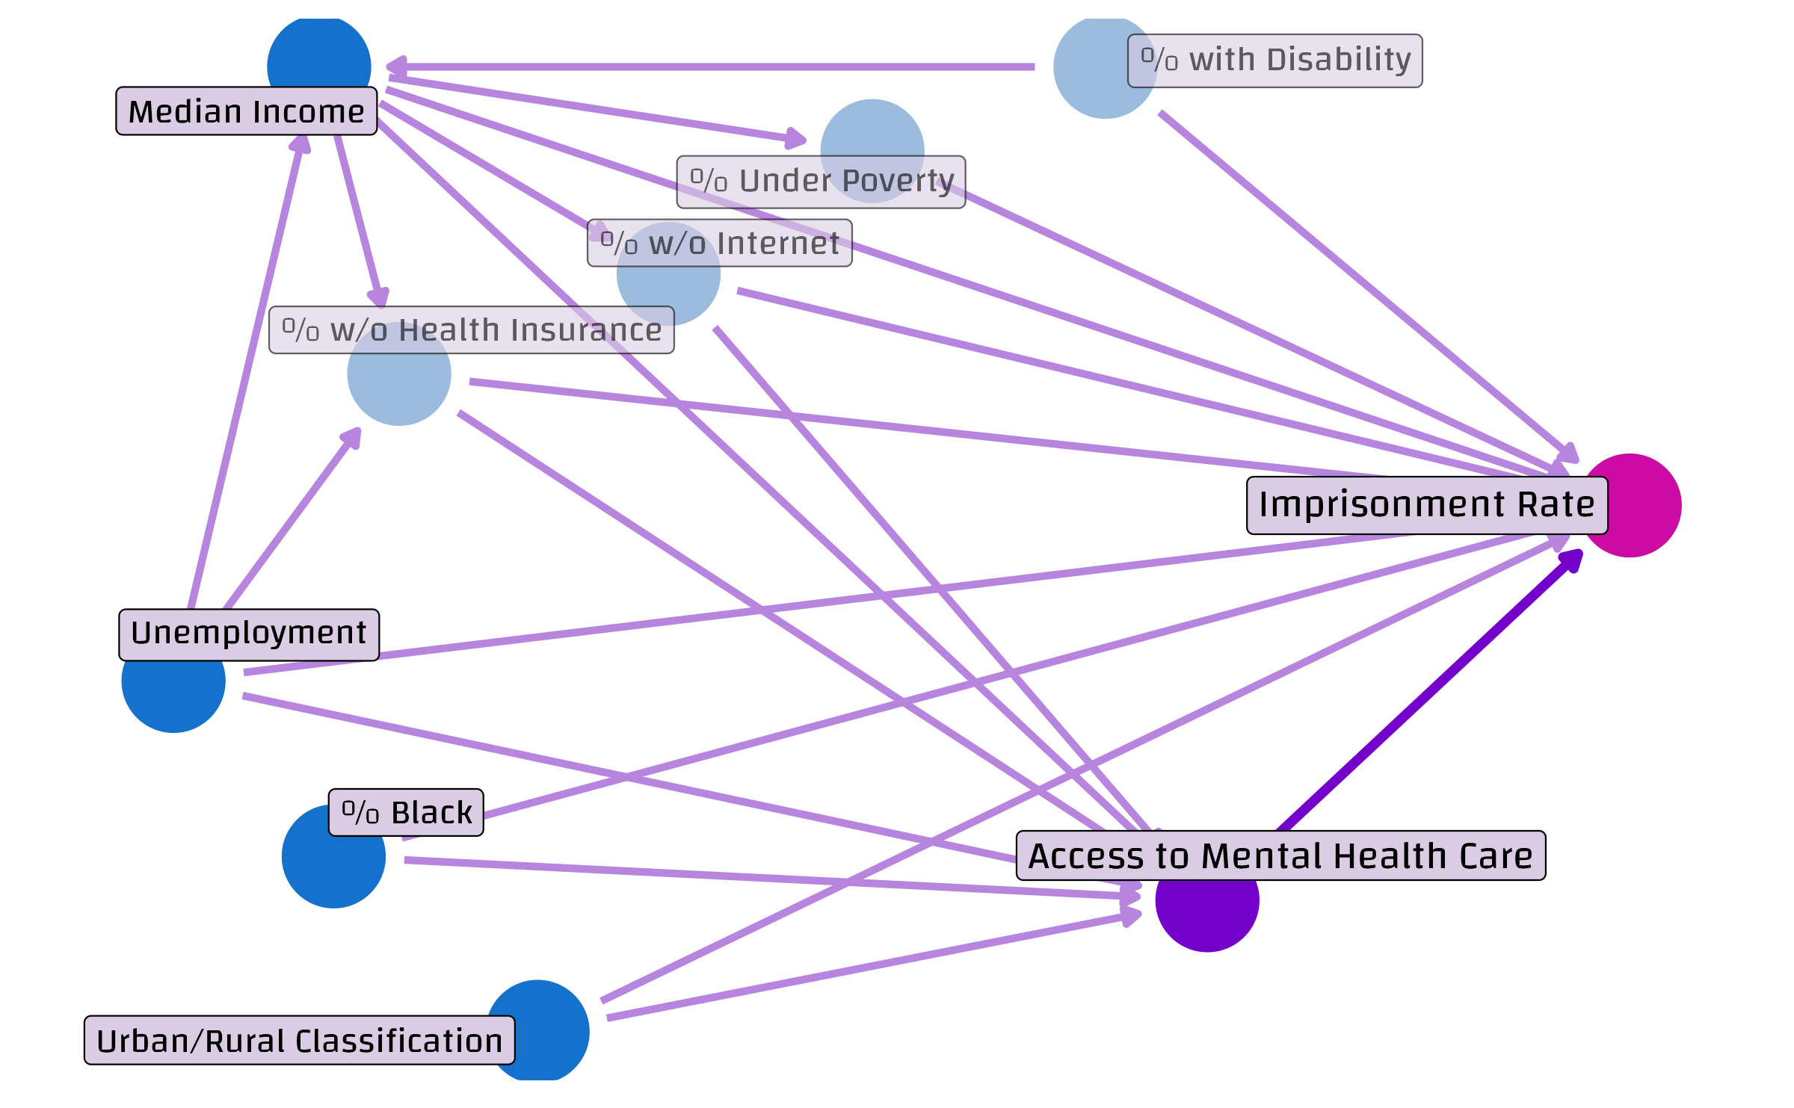
Modeling
Notes:
These variables are so closely related to median income and unemployment rates that their impact is accounted for when I control for median income, unemployment rate, the percent of Black residents, and the tract’s urban/rural classification.

Slide 17
Bayesian Modeling
Why Bayes?
Determine the “probability of direction”
No arbitrary threshold for “significance”
Notes:
The Bayesian method differs from the common frequentist methods because these models will draw 10,000 iterations of the model (the first 5,000 draws are discarded as warm up), and I will assess the probability of direction for the coefficients in each model.
Instead of statistical “significance,” I will discuss the results in terms of probability of direction based on the distribution of coefficients.

Slide 18
Bayesian Modeling
Why Bayes?
Determine the “probability of direction”
No arbitrary threshold for “significance”
Multilevel Model
Consider the variation and distribution between and within each county to inform the prediction for a specific tract
Notes:
I want the model to consider the distribution of relationships within each county to inform the prediction for a specific tract; I also want to consider the variability between counties.

Slide 19
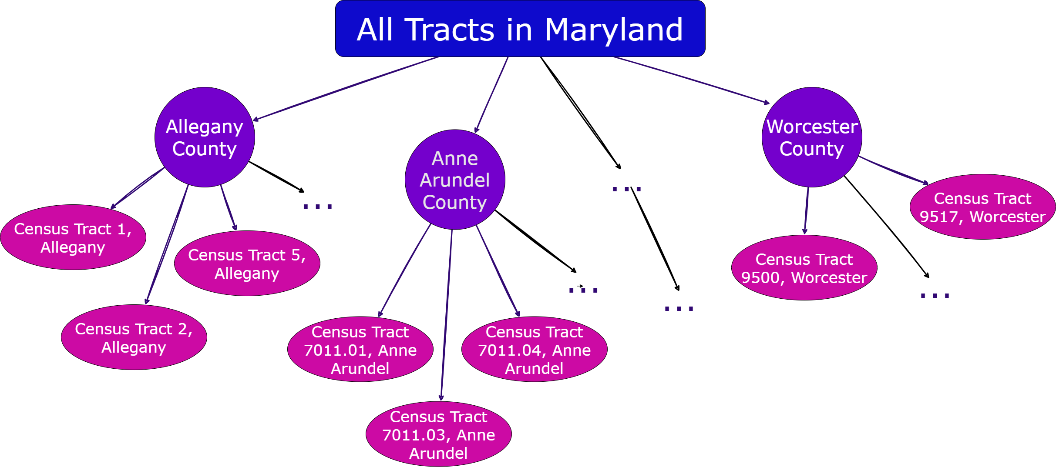
Multilevel Model

Slide 20
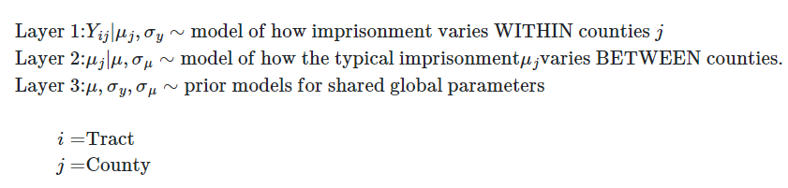
Math

Slide 21
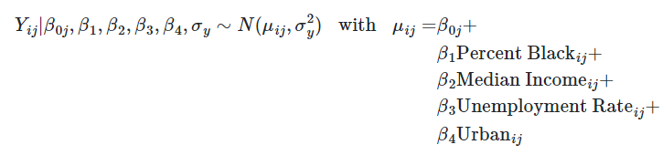
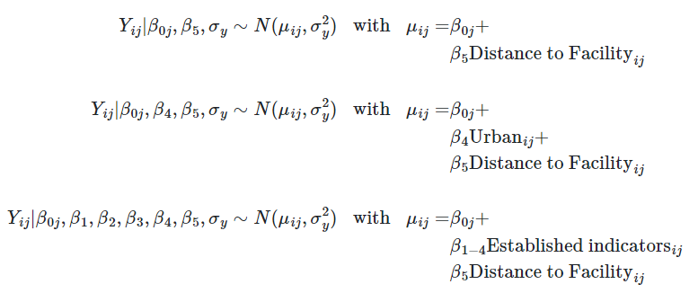
Math

Slide 22
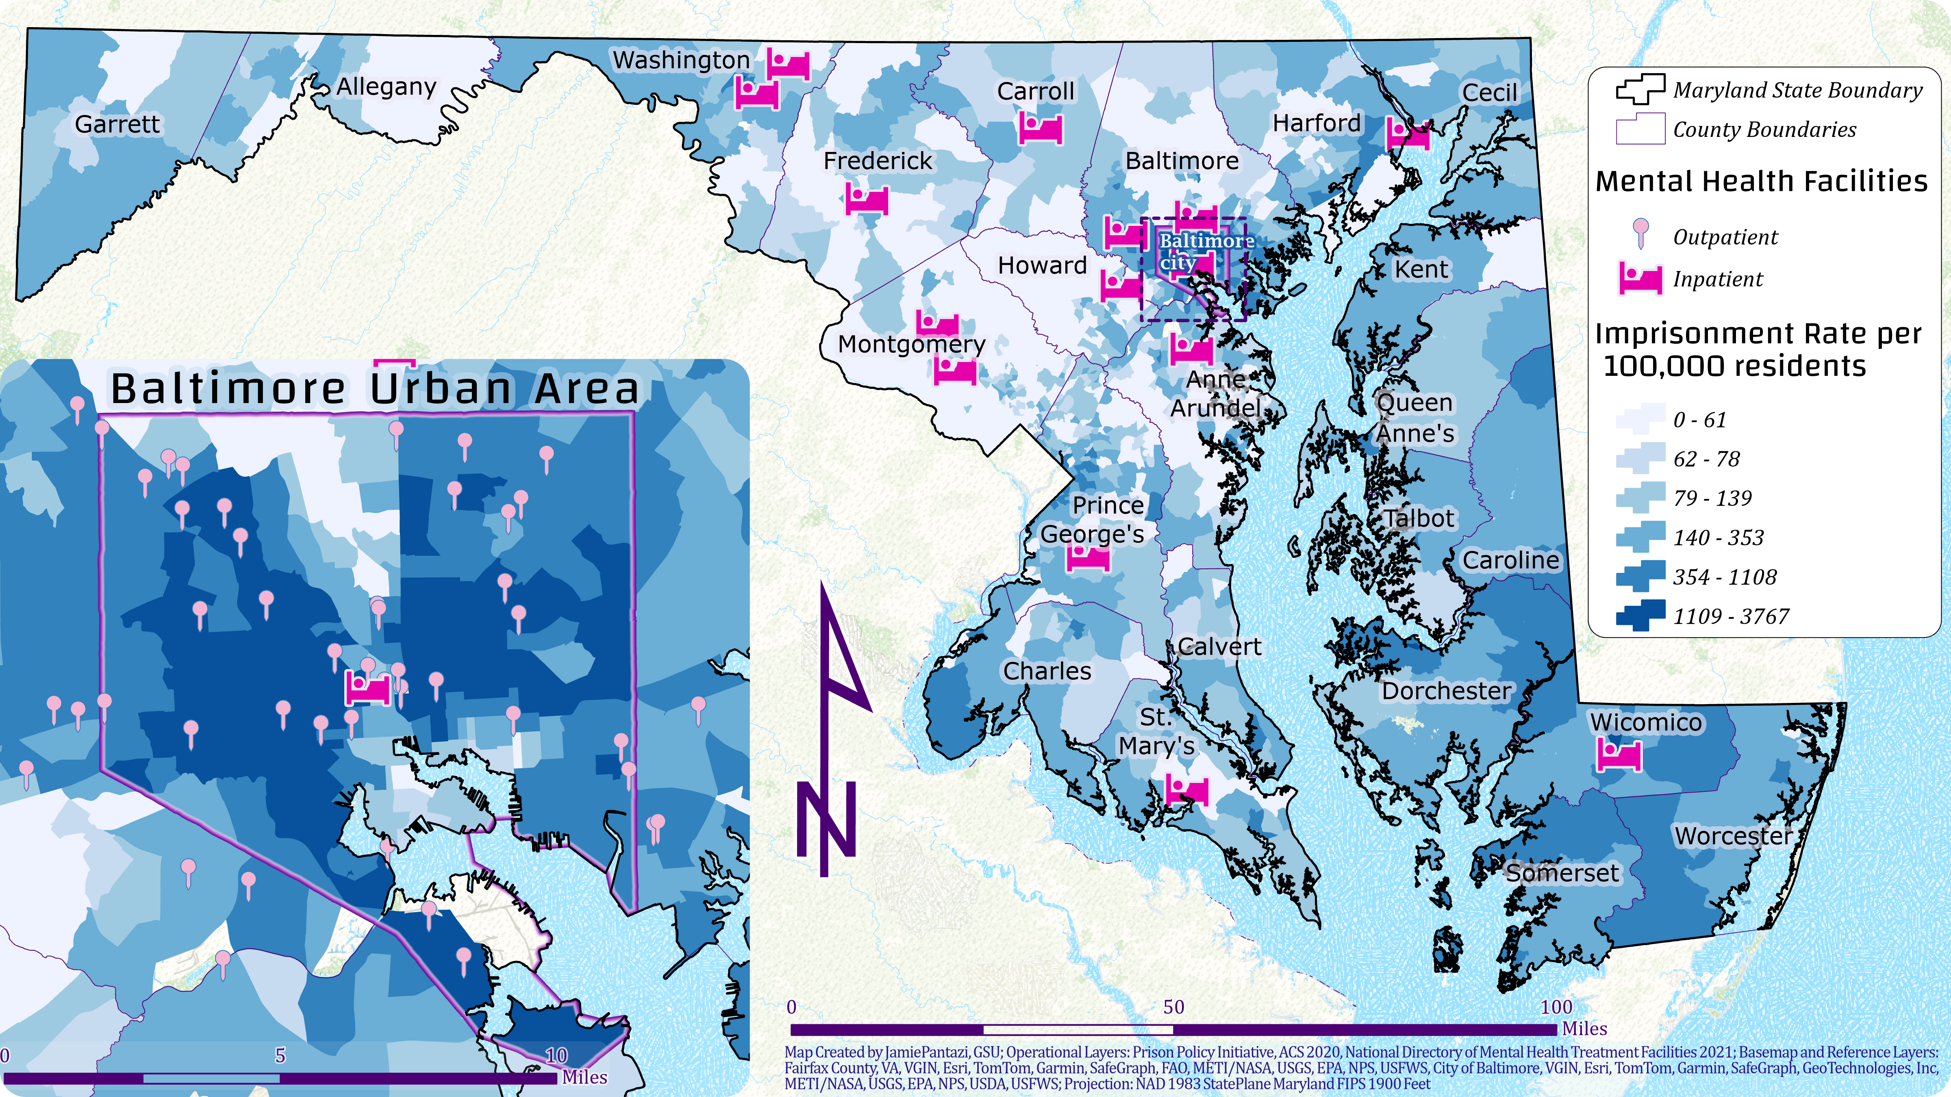

Slide 23
Summary
Tract Characteristics | Mean | Median | Std Dev | Min | Max
Imprisonment Rate per 100,000 | 314 | 139 | 497 | 0 | 3,767
Total Population | 4,104 | 3,911 | 1,603 | 776 | 11,509
Median Income | $107,055 | $101,406 | $44,815 | $14,464 | $250,001
% Black | 31.0% | 18.5% | 30.2% | 0.0% | 99.7%
Unemployment Rate | 5.5% | 4.5% | 3.9% | 0.0% | 31.2%
% Rural | 14.9% | 0.0% | 32.1% | 0.0% | 100%
Notes:
median income across all tracts in Maryland was $101,406, compared to a national median income of $62,529
average percentage of Black residents for each tract was 31.0%, compared to only 11.2% nationwide
tracts in Maryland have a lower percentage of rural housing than the national average by about half

Slide 24
Summary
Tract Characteristics | Mean | Median | Std Dev | Min | Max
Imprisonment Rate per 100,000 | 314 | 139 | 497 | 0 | 3,767
Total Population | 4,104 | 3,911 | 1,603 | 776 | 11,509
Median Income | $107,055 | $101,406 | $44,815 | $14,464 | $250,001
% Black | 31.0% | 18.5% | 30.2% | 0.0% | 99.7%
Unemployment Rate | 5.5% | 4.5% | 3.9% | 0.0% | 31.2%
% Rural | 14.9% | 0.0% | 32.1% | 0.0% | 100%
Distance to Nearest Facility | Mean | Median | Std Dev | Min | Max
Driving Miles to Mental Health Facility | 4.3 | 2.7 | 5.0 | 0.1 | 51.8
Travel Time to Mental Health Facility | 9 min | 8 min | 7 min | 1 min | 74 min
Driving Miles to Inpatient Facility | 12.0 | 8.7 | 13.8 | 0.2 | 119.9
Travel Time to Inpatient Facility | 22 min | 19 min | 15 min | 1 min | 139 min
Driving Miles to Inpatient Facility with Crisis Intervention | 22.3 | 16.6 | 24.7 | 0.4 | 152.4
Travel Time to Inpatient Facility with Crisis Intervention | 36 min | 30 min | 29 min | 2 min | 184 min
Notes:
average travel time to any facility is less than ten minutes, and under thirty minutes to inpatient facilities with crisis intervention
some tracts are up to 74 minutes away for any mental health facility, 139 minutes for inpatient facilities, and up to almost three hours for an inpatient facility with crisis intervention

Slide 25
Summary
Facility Characteristics | All | Count | Inpatient | Count
Inpatient Services | 8.6% | 20 | 100% | 20
Outpatient Services | 86.7% | 202 | 60.0% | 12
Partial Hospitalization Services | 17.2% | 40 | 90.0% | 18
Residential Services | 13.3% | 31 | 5.0% | 1
Telehealth Services | 65.7% | 153 | 35.0% | 7
Serves Adults | 88.0% | 205 | 90.0% | 18
Crisis Intervention | 30.0% | 70 | 50.0% | 10
Walk-ins Accepted | 18.9% | 44 | 65.0% | 13
Federally Qualified Health Center | 11.2% | 26 | 0.0% | 0
Accepts Medicaid | 93.6% | 218 | 100% | 20
Accepts Medicare | 69.1% | 161 | 100% | 20
Payment Assistance | 17.6% | 41 | 5.0% | 1
Sliding Scale | 35.6% | 83 | 5.0% | 1
Notes:
only 8.6%, or 20 facilities, offer inpatient care
primary focus will be inpatient facilities with crisis intervention
inadequate mental health outpatient care and cost-prohibitive preventative care is another dimension

Slide 26
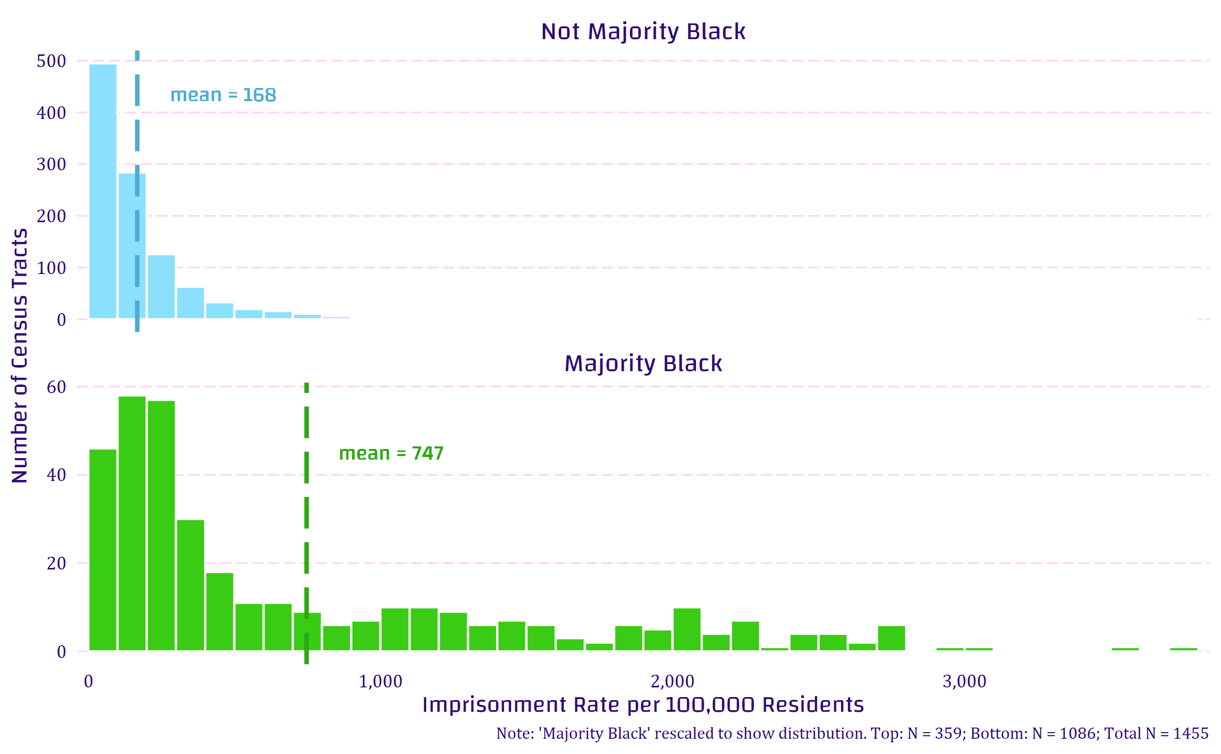
Distribution of Imprisonment Rate by Race
Notes:
a clear and obvious characteristic related to higher rates is race
census tracts that have a majority Black population have, on average, much higher rates of imprisonment
While majority Black tracts had over 100 tracts with an imprisonment rate above 1,000 per 100,000 people, tracts without a majority Black population had only eight above 1,000 per 100,000 people

Slide 27
Bayesian Regression
Established indicators
Percent Black
Median Income
Unemployment Rate
Urban/Rural Classification
County Highlights
Distance
Distance only
Distance and Urban/Rural Classification
Distance and All Variables

Slide 28
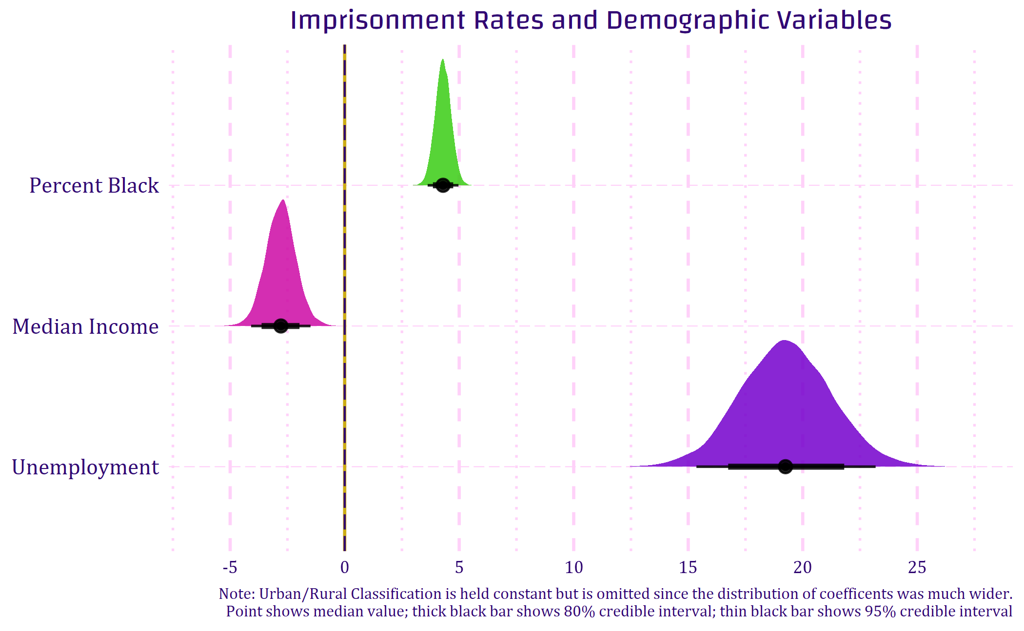
Established Indicators
Notes:
Percent Black – 4.3 median – 100%
Median Income – -2.8 median – 100%
Unemployment – 19.2 median – 100%

Slide 29
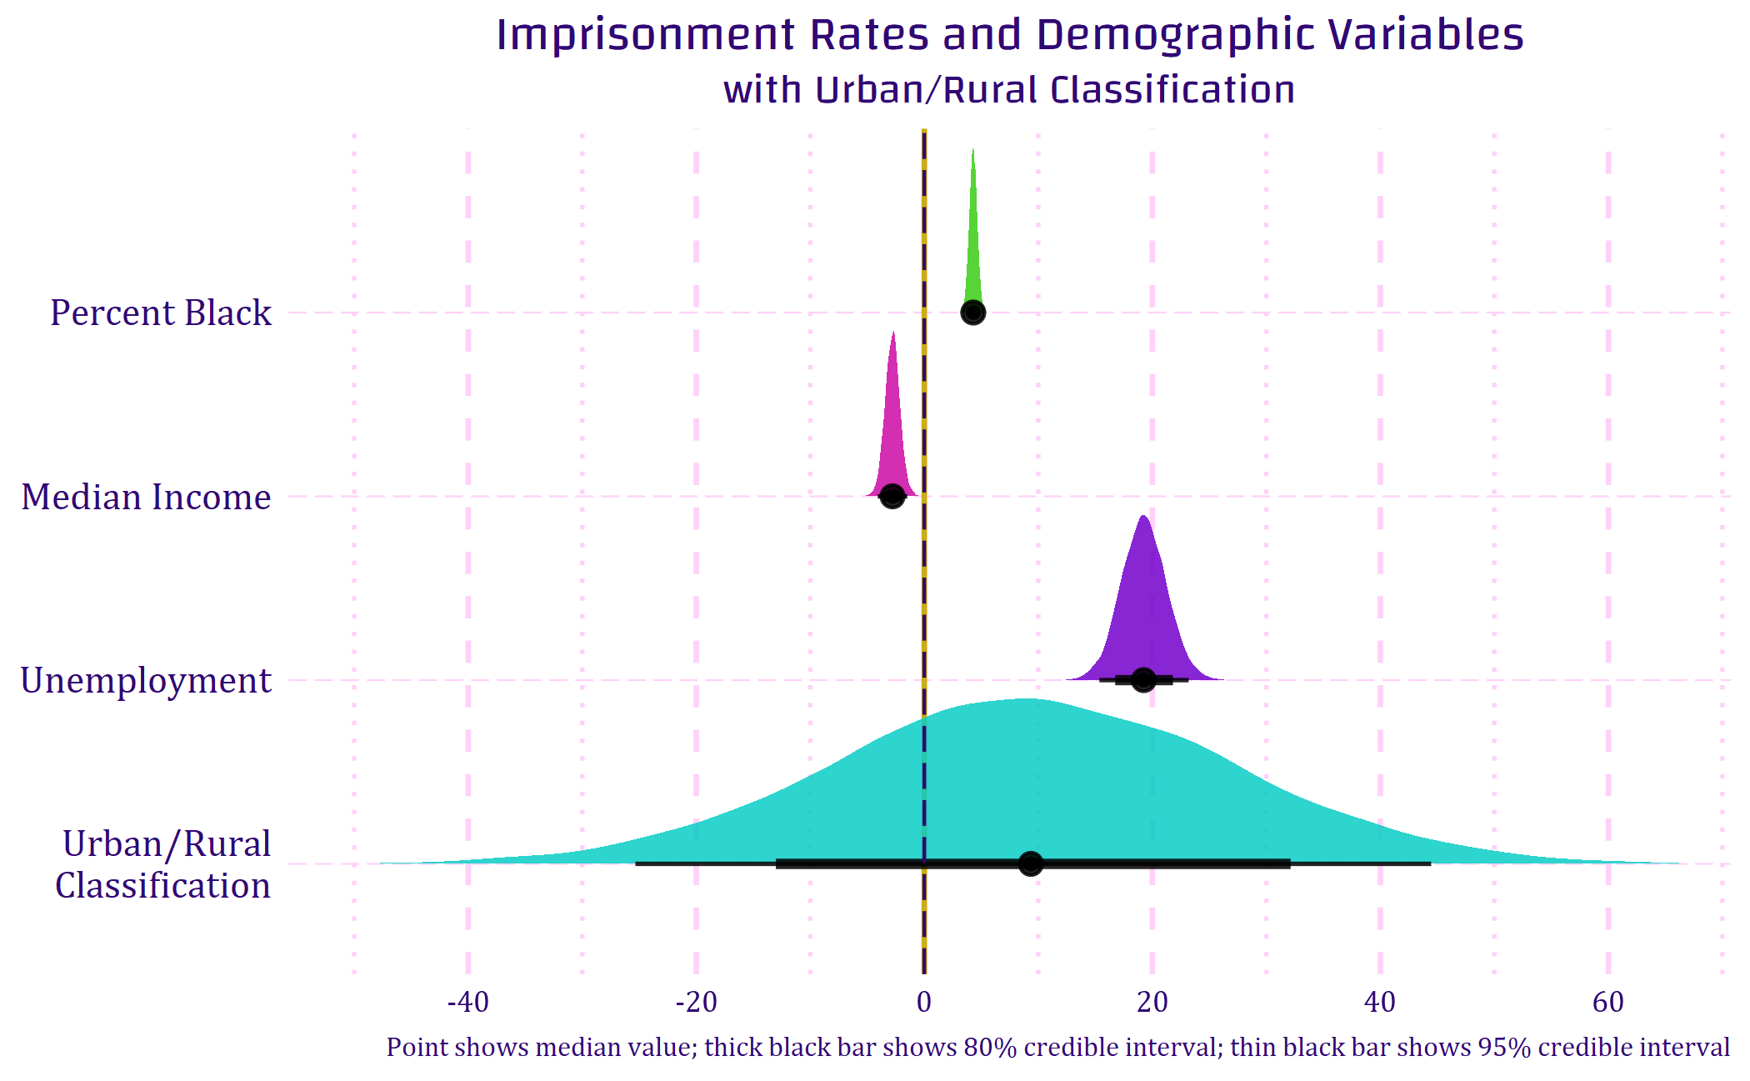
Established Indicators
Notes:
Percent Black – 4.3 median – 100%
Median Income – -2.8 median – 100%
Unemployment – 19.2 median – 100%
Urban – 9.3 median – 70.6%

Slide 30
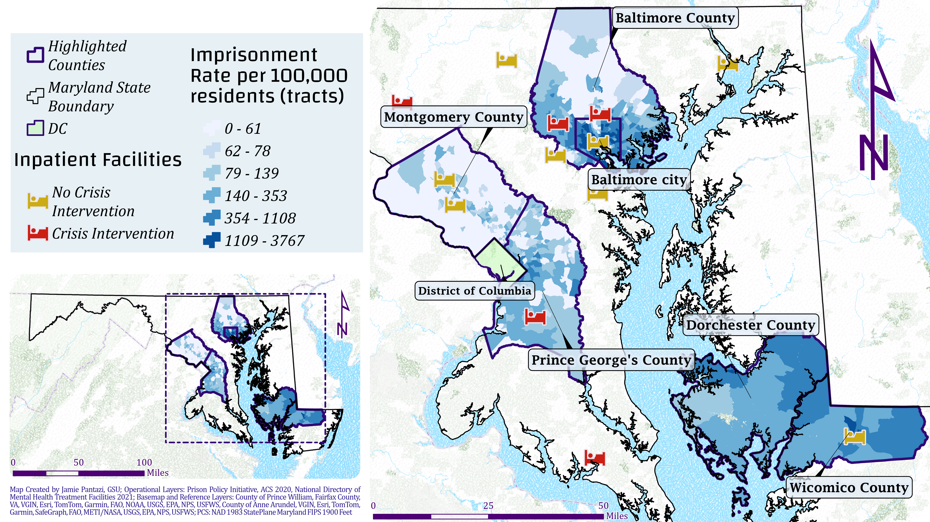

Slide 31
Selected Counties
County | Imprisonment Rate | Percent Black | Median Income | Unemployment Rate
Baltimore Metro Area
Baltimore City | 1,167 | 63.0% | $73,963 | 8.7%
Baltimore County | 260 | 27.3% | $101,468 | 4.9%
DC Suburbs
Montgomery County | 63 | 18.0% | $140,741 | 4.6%
Prince George's County | 174 | 63.3% | $101,367 | 6.5%
Rural Peninsula
Dorchester County | 511 | 23.8% | $67,102 | 7.3%
Wicomico County | 688 | 28.8% | $72,223 | 7.7%
Notes:
Baltimore county surrounds Baltimore city on all sides
DC suburbs, Montgomery and Prince George’s counties, have a greater disparity in the percent of Black residents than Baltimore city and Baltimore county, and an almost identical income disparity.
Baltimore city has almost twice the unemployment and almost four and half times the imprisonment rate as Baltimore county
Two rural peninsula counties were chosen because they had imprisonment rates higher than other rural areas
They stand out as having a lower percent of Black residents than the other counties (save Montgomery county)
Lower median income than all the other selected counties (including Baltimore city)

Slide 32
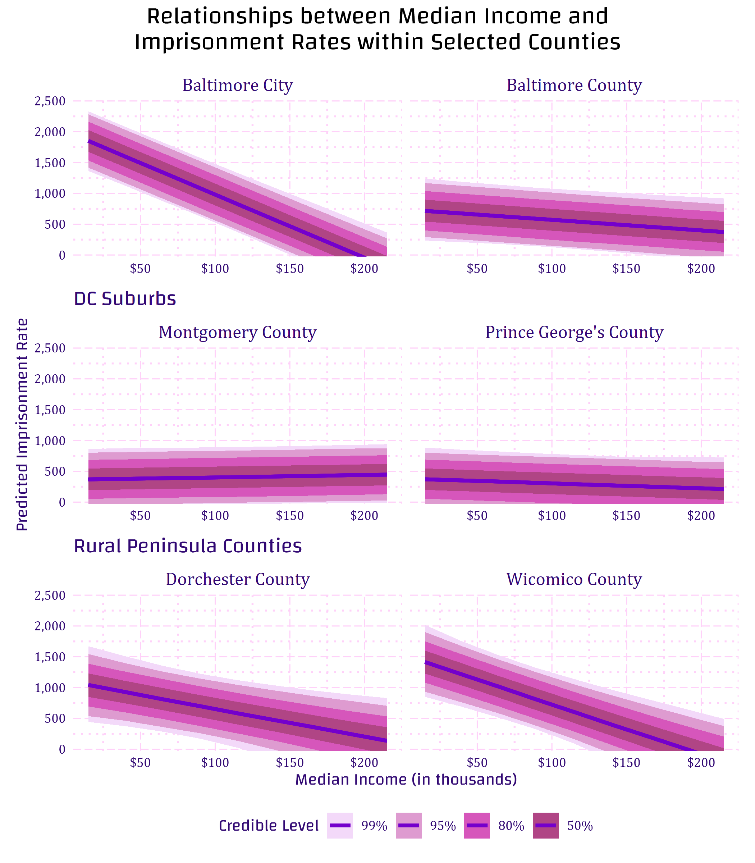
Selected Counties
Notes:
most noticeable correlations between income and imprisonment can be seen in the plots for Baltimore city and the two rural peninsula counties, Dorchester and Wicomico
slopes for the suburban counties around DC are almost entirely flat, and there is only a slight downward slope for Baltimore county

Slide 33
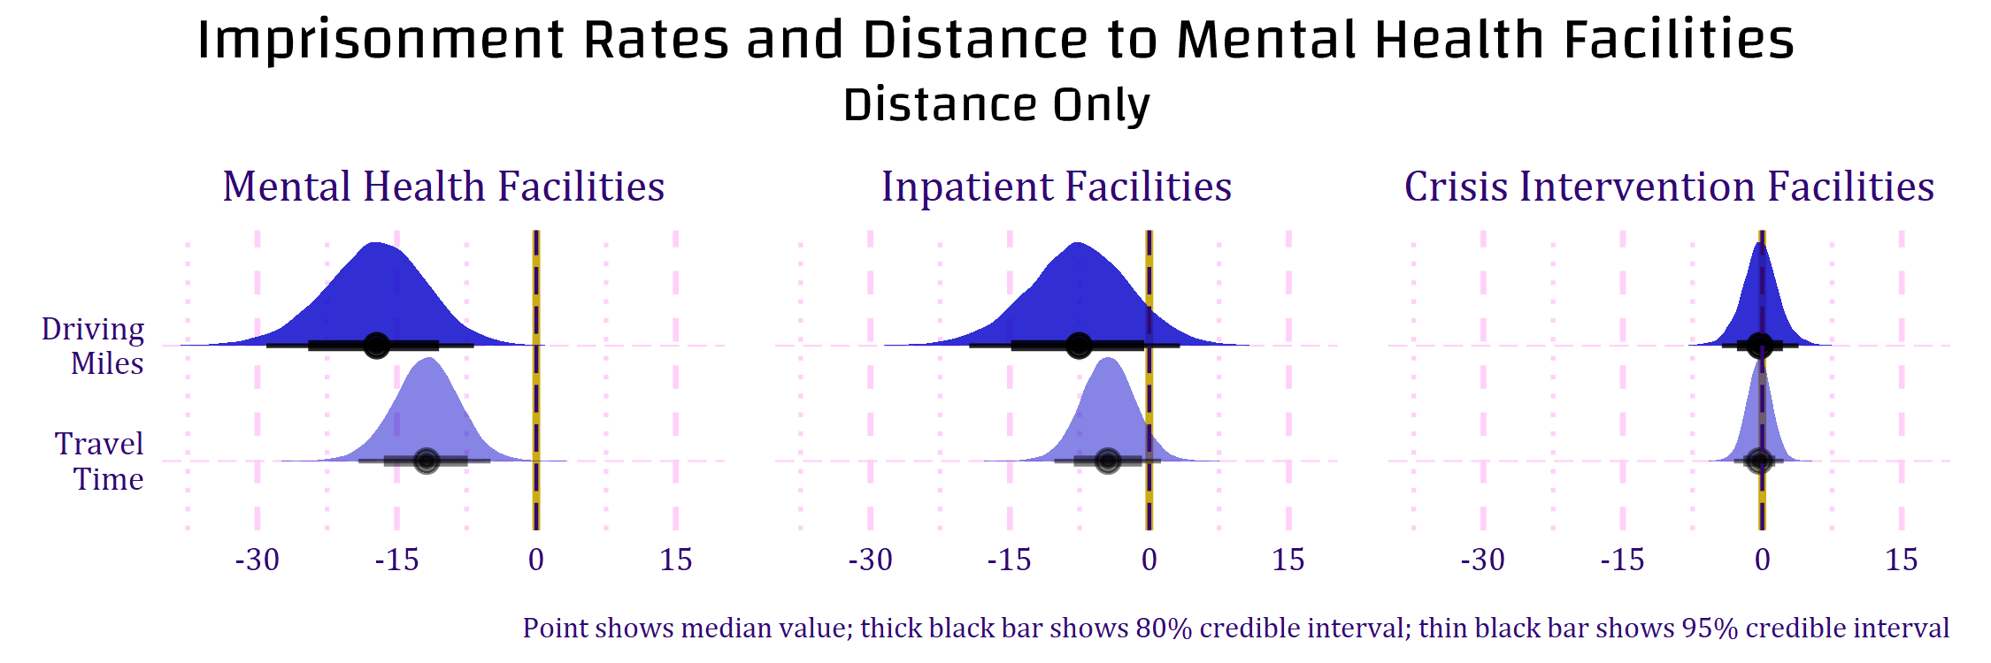
Proximity to mental health facilities
Notes:
Mental Health – -17.2 – 99.9%
Inpatient – -7.5 – 91.6%
Crisis - -0.2 – 55%

Slide 34
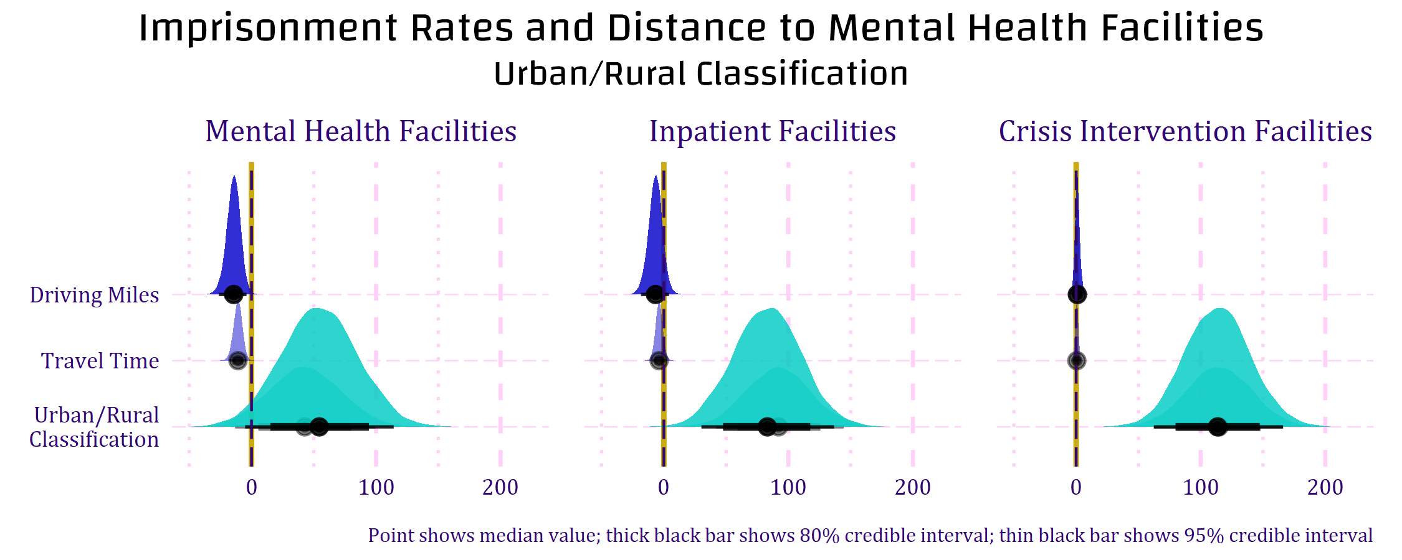
Proximity to mental health facilities
Notes:
Mental Health – -14.3 – 99.6%
Inpatient – -6.6 – 89.3%
Crisis - +0.9 – 55%
Urban – 54 – 96.2%, 83 – 100%, 114 – 100%

Slide 35
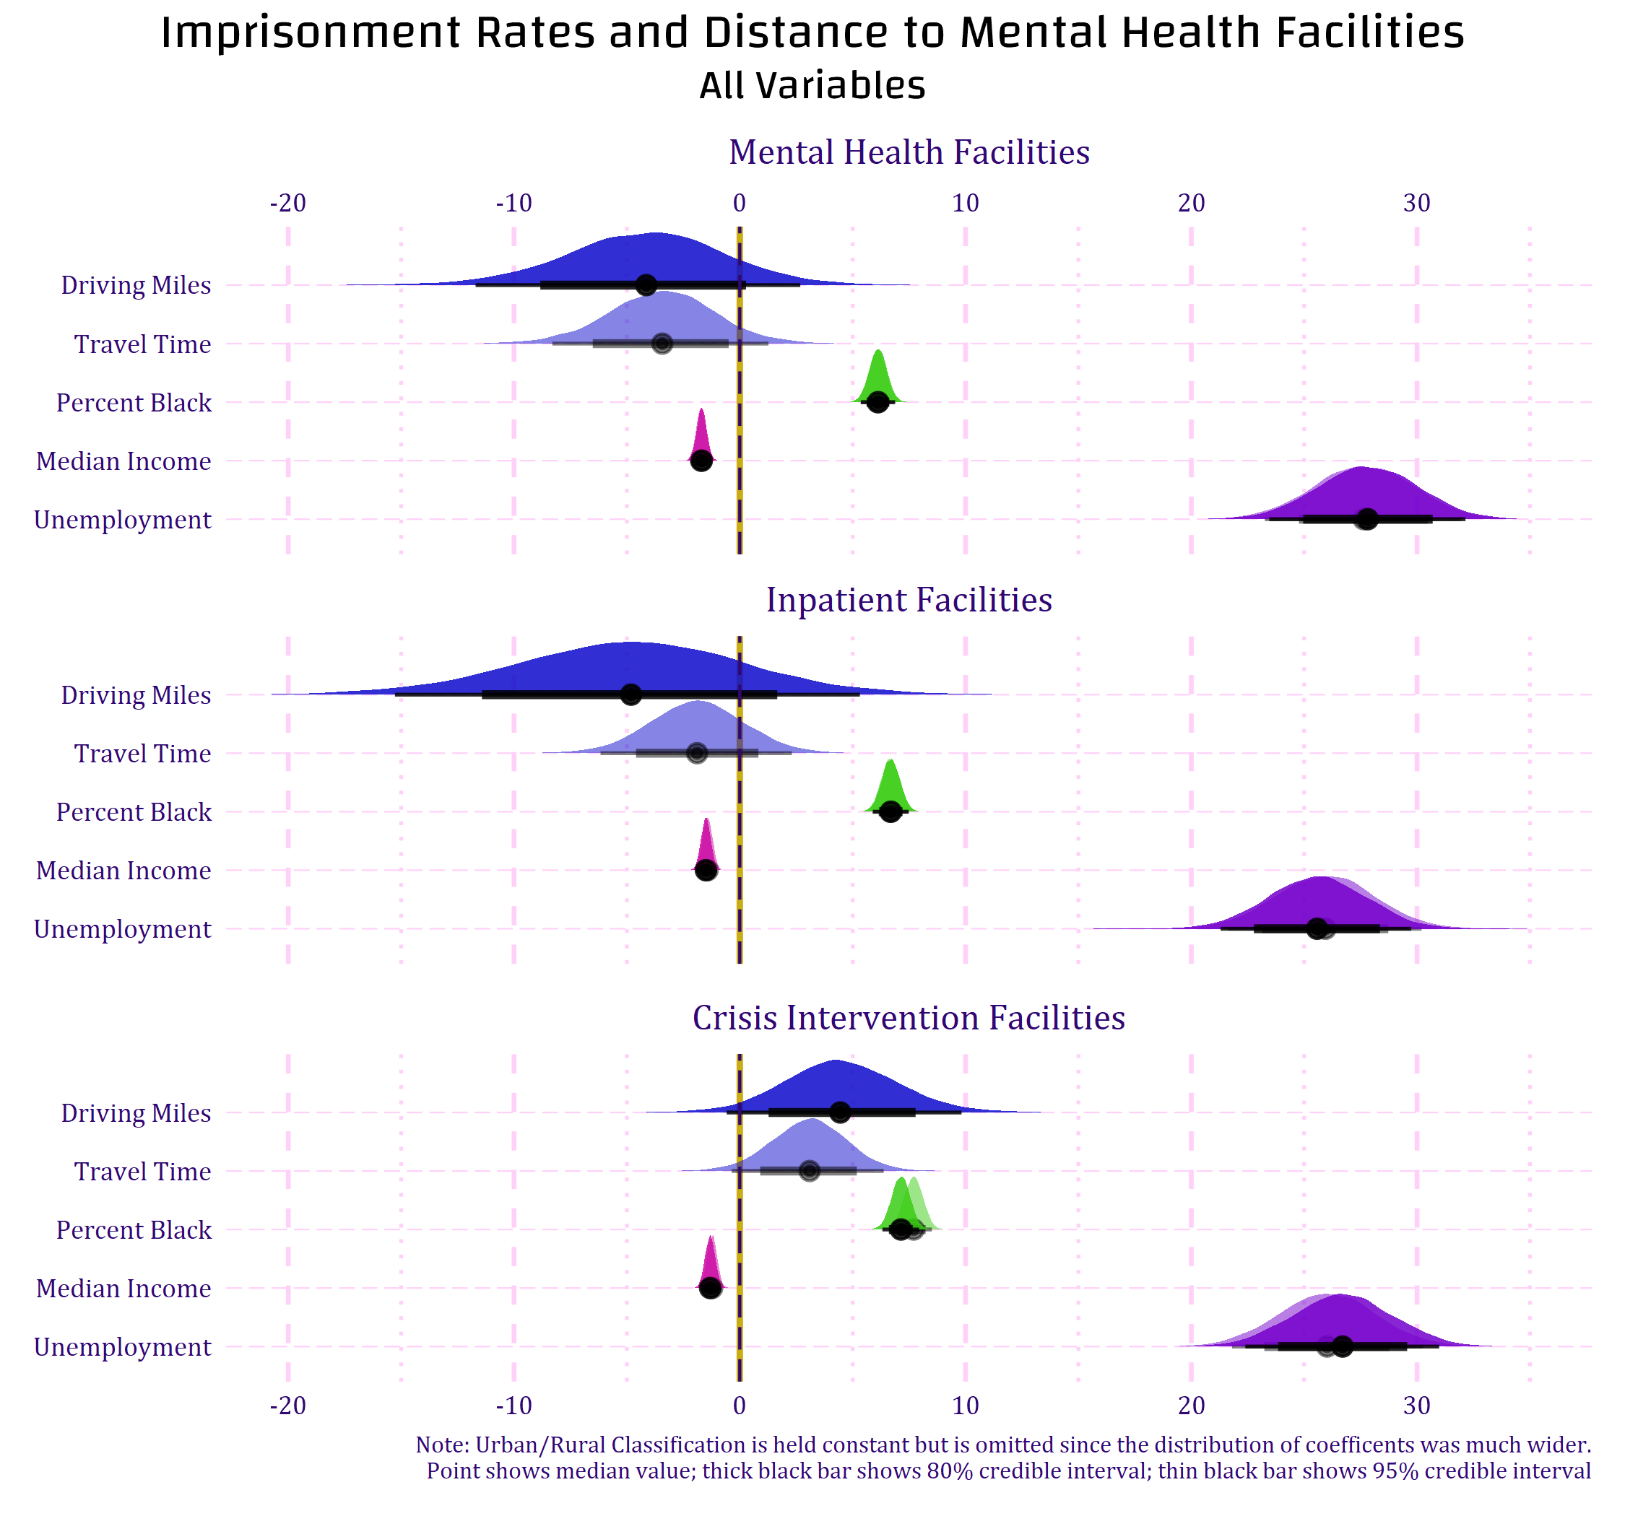
Key Findings
Distance did not cause meaningful change for established indicators
Percent Black and Unemploy-ment moved further from zero
Median income moved closer to zero
Notes:
Mental Health – -4.1 – 88.6%
Inpatient – -4.8 – 83.4%
Crisis - +4.5 – 96.2%
Percent Black – 6.1, 6.7, 7.1 – 100%
Median Income – -1.7, -1.5, -1.3 – 100%
Unemployment – 27.8, 25.6, 26.7 – 100%

Slide 36
Key Findings
Distance did not cause meaningful change for established indicators
Percent Black and Unemploy-ment moved further from zero
Median income moved closer to zero
Distance to inpatient facilities with crisis intervention
Median coefficient – +4.5
96.2% certainty of direction
Notes:
Mental Health – -4.1 – 88.6%
Inpatient – -4.8 – 83.4%
Crisis - +4.5 – 96.2%
Percent Black – 6.1, 6.7, 7.1 – 100%
Median Income – -1.7, -1.5, -1.3 – 100%
Unemployment – 27.8, 25.6, 26.7 – 100%

Slide 37
Key Findings
Distance did not cause meaningful change for established indicators
Percent Black and Unemploy-ment moved further from zero
Median income moved closer to zero
Distance to inpatient facilities with crisis intervention
Median coefficient – +4.5
96.2% certainty of direction
Narrower distribution for travel time
Notes:
Mental Health – -4.1 – 88.6%
Inpatient – -4.8 – 83.4%
Crisis - +4.5 – 96.2%
Percent Black – 6.1, 6.7, 7.1 – 100%
Median Income – -1.7, -1.5, -1.3 – 100%
Unemployment – 27.8, 25.6, 26.7 – 100%

Slide 38
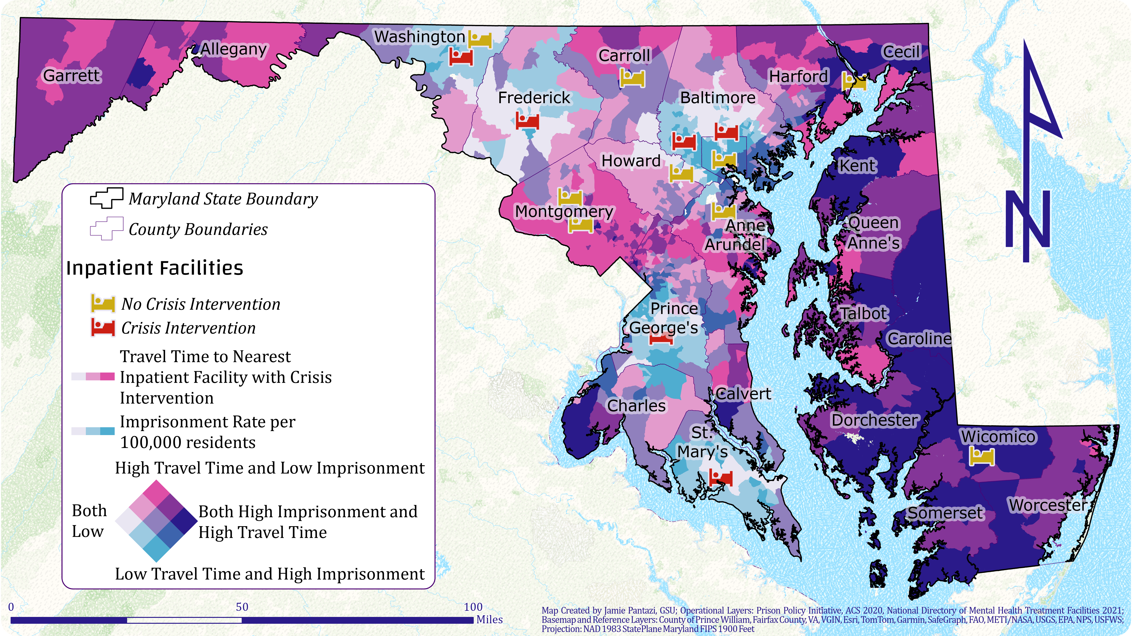

Slide 39
Further Research
Availability of Care
Capacity
Quality of care
Adequate
Accessible
Appropriate

Slide 40
Further Research
Availability of Care
Income Threshold for Black Communities
Capacity
Quality of care
Adequate
Accessible
Appropriate
Does a higher median income drive down imprisonment rates in majority Black communities?
DC suburbs have a higher overall income and much lower imprisonment rate, but similar proportion of Black residents

Slide 41
Further Research
Availability of Care
Income Threshold for Black Communities
Capacity
Quality of care
Adequate
Accessible
Appropriate
Does a higher median income drive down imprisonment rates in majority Black communities?
DC suburbs have a higher overall income and much lower imprisonment rate, but similar proportion of Black residents
Mental Health for Re-entry
Lack of health insurance due to employment barriers
Stigma around seeking help, especially with in prison culture
Support for families of people in prison

Slide 42
Conclusion
Illumination the greater issue of transparency around mental health care.
Call to future researchers to continue pressing these institutions to increase transparency to enable researchers and the greater public to analyze and assess their work and impact
New datasets:
Maryland facilities list with their characteristics according to the SAMHSA’s National Directory of Mental Health Treatment Facilities 2021
Maryland tracts with nearest facilities (mental health, inpatient, and in-patient with crisis intervention) and the other characteristics for each of the nearest facilities in each category

Slide 43
WARNING
Inpatient mental health care must not become a replacement for carceral detention
Beware the threat of profit-driven agendas that would be happy to rehouse those they deem “criminals” in mental health hospitals instead of prisons
We must not be appeased by these attempts to placate our demands with a mere vocabulary adjustment
“A rose by another name” is not progress!

Slide 44



Thank you
recommended readings
Michelle Alexander’s The New Jim Crow: Mass Incarceration in the Age of Colorblindness.
Angela Davis’ Masked Racism: Reflections on the Prison Industrial Complex
Ruth Wilson Gilmore’s Golden Gulag: Prisons, Surplus, Crisis, and Opposition in Globalizing California
Robert Whitaker’s Mad in America: Bad Science, Bad Medicine, and the Enduring Mistreatment of the Mentally Ill.
Emily Widra’s “Where people in prison come from: The geography of mass incarceration”
Jamie Pantazi
January 2024 - GSU
Dr. Heiss – Bayesian Statistics

